Slide 1
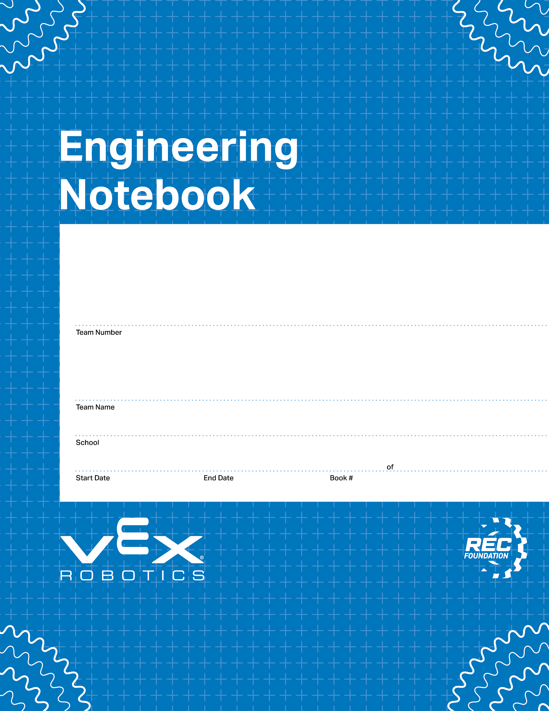
65544T
DynoBots
White Oak Elementary/Mills Park Middle
00/00/0000
00/00/0000
1
1
V3.0 Date 6.10.24

Slide 2
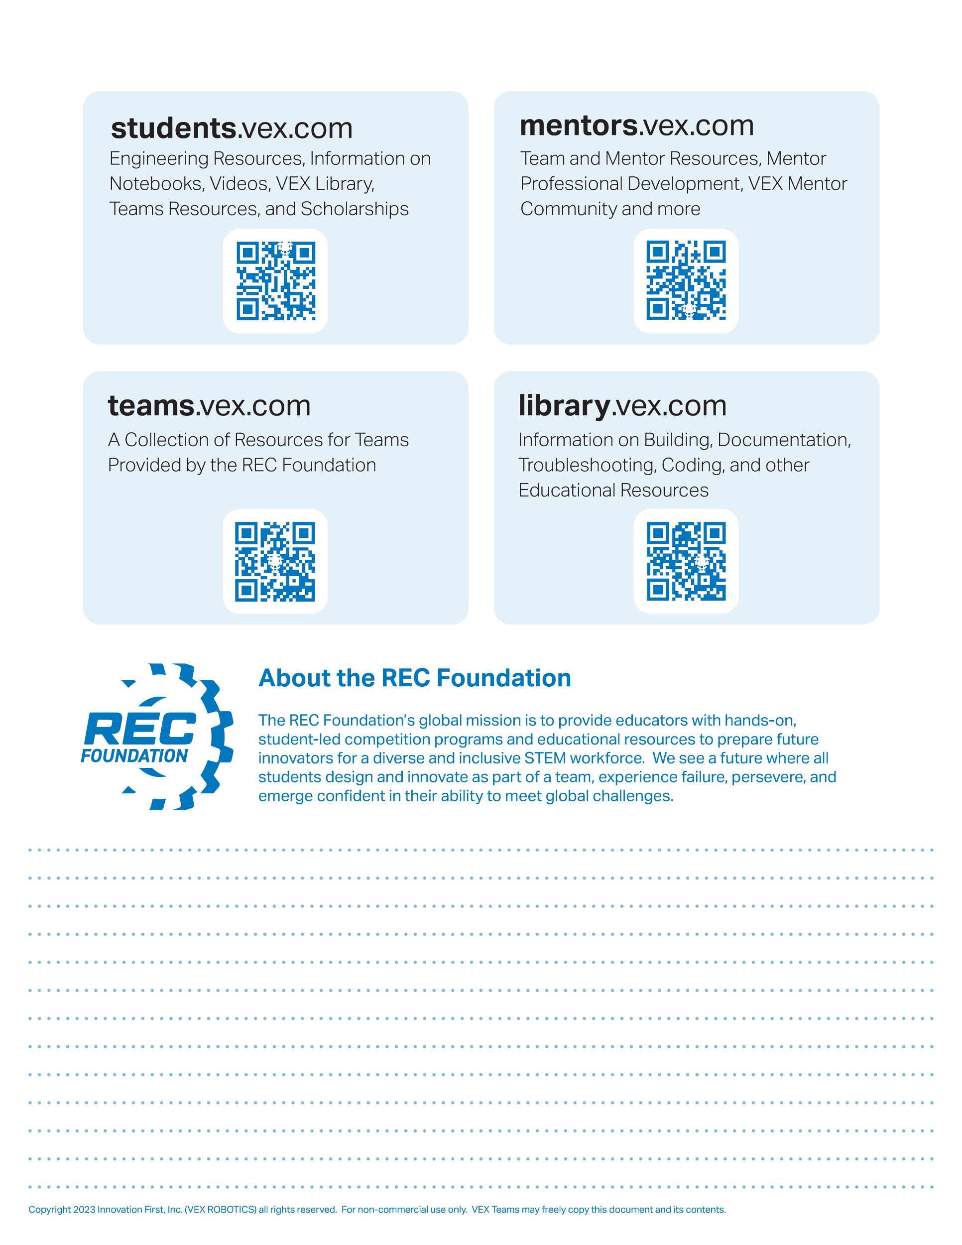
Resources
engineering.vex.com
notebooking.vex.com
coding.vex.com
Judging Rubric for Notebooks
vex.com
roboticseducation.org
VIQRC 2024-2025 Game - Rules & Game Video
Send suggestions and comments about these Digital Notebooks and Digital Parts
to notebooks@vex.com

Slide 3
4 Recap of August
5 Recap of September
6 Recap of October
7 Recap of November
8 Recap of December
9 Recap of January
10 Recap of February
12 Claw bot design
13 Swish bot design 1
14 Swish bot design 2
16 Port mappings
17 Controller Specifications

Slide 4
Recap of August
In the month of August, we started building the board and the goals. We had different roles such as builder 1, builder 2, supply manager, and floater. On the first class, we quickly built the main board. Over the next classes in August, we started working on the switches and loading station. Since we had just started robotics, we scrambled for a tutorial to use to push us in the right direction. That is when we found the claw bot.

Slide 5
Recap of September
In the month of September, we finished the claw bot. However, we realized that the weight was to much to lift the ball. Then, on September 19th, we went to a local scrimmage and realized that this year's robo model was the swishbot. After noticing this, we immediately started our build on the swishbot.

Slide 6
Recap of October
In the month of October, it took us several classes to build the swish bot. We encountered a problem where the rollers weren't aligned properly and couldn't rub against each other due to a malfunction. Our solution was to add small washers, which shifted the rollers to the left, and once we did that, everything worked! But then we started to practice our driving and then we had a problem. The controller's direction was opposite! After some lucky tweaking, we finally managed to make it normal.

Slide 7
Recap of November
In November, we started working on our autonomous project. First, we researched the code and watched several videos on the topic, which took about two full 3-hour classes. Afterward, we began developing the autonomous system. A few classes in, we made some progress and started programming it to perform basic motions. Initially, we used the sensors, but we encountered a problem where the roller wasn't functioning properly, and it wasn't processing correctly. We brainstormed and tried to troubleshoot, and eventually realized we could use the sensors in a different way. When we implemented this approach, it worked a little better, but then the launcher moved down unexpectedly. To resolve this, we watched more tutorials and learned how to fix the issue. Although we made progress, we were still a little confused at times.

Slide 8
Recap of December
In the month of December, we participated in a competition at Charlote. In the competition we came 6th in driving skills and 18th in team alliance. When we got back we tried to make the launcher go down faster, but we had a problem with changing the string. This caused the robot to break and we couldn't fix it back. At the end we were trying to find ideas for a new robot and decided to build the claw bin. A robot we never thought of.

Slide 9
Recap of January
In the month of January, after winter break we started the claw bin. We brain stormed what to do. We started to build the bin. We got to many problems during the build phase. One problem is how to flip the bin to make the bottom switch and since we were unable to solve these problems, we decided to build the swish bot 2.0. We started building the swish bot 2.0 and finished it in the same month. At end of the month we started programming our first working autonomous.

Slide 10
Recap of Febuary
In February, we continued working on the autonomous system, but we were still stuck on the code. We reached out to a well-known team for help, and they guided us through the obstacles. With their advice, we finally shot a wonderful hoop. We were able to complete both the first top switch and the first bottom switch. After approximately 42 and a half classes, we managed to accomplish the other side as well. It was a significant and motivating success. We then participated in another local scrimmage, where we finished in 3rd place. We earned 52 points in driver skills and 34 points in autonomous. Overall, it was a great experience, and this is our journey in VEX Robotics.

Slide 11
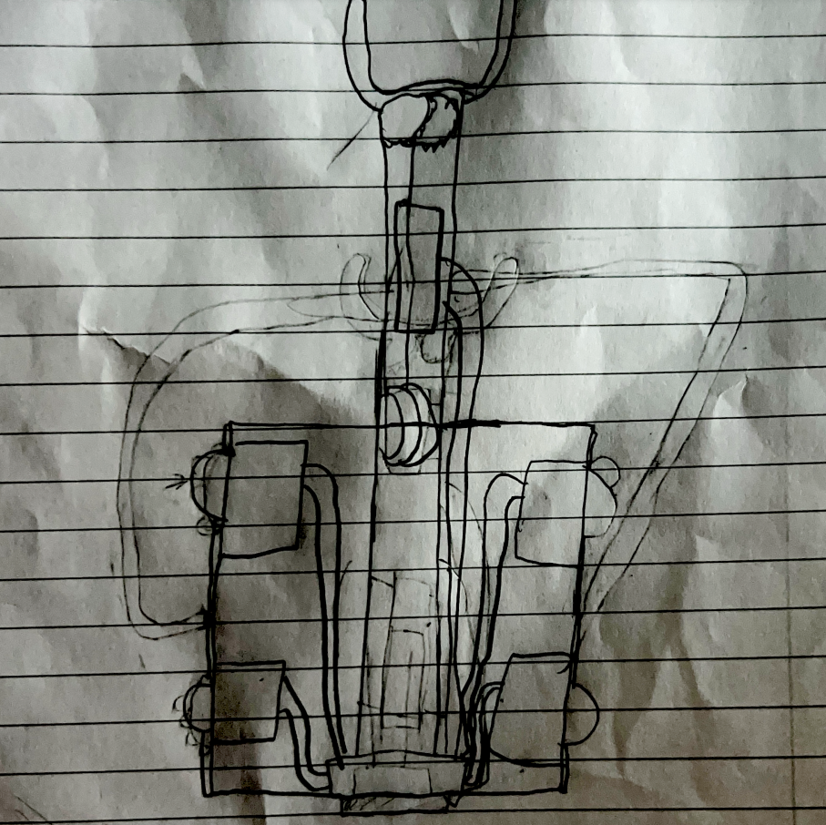
Claw bot

Slide 12
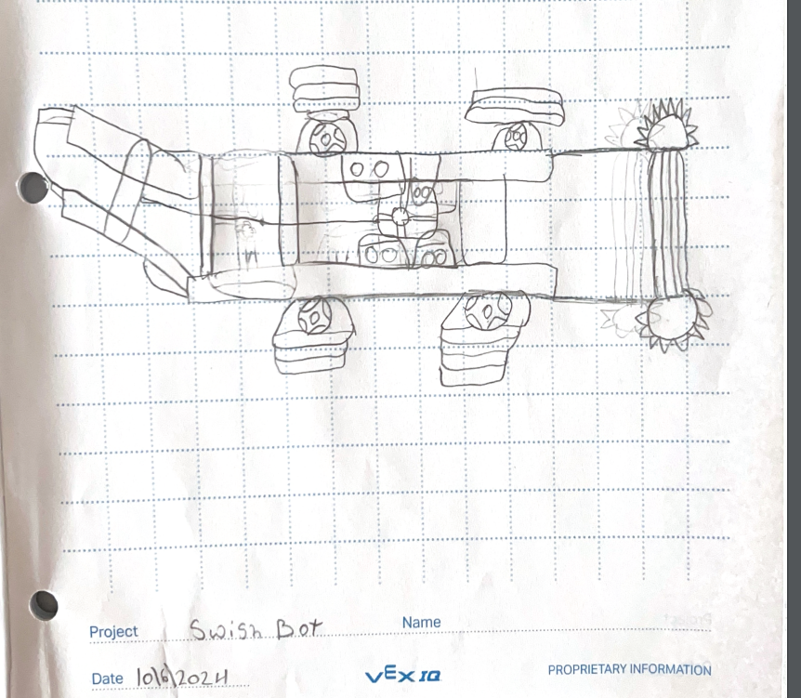
Swish bot

Slide 13
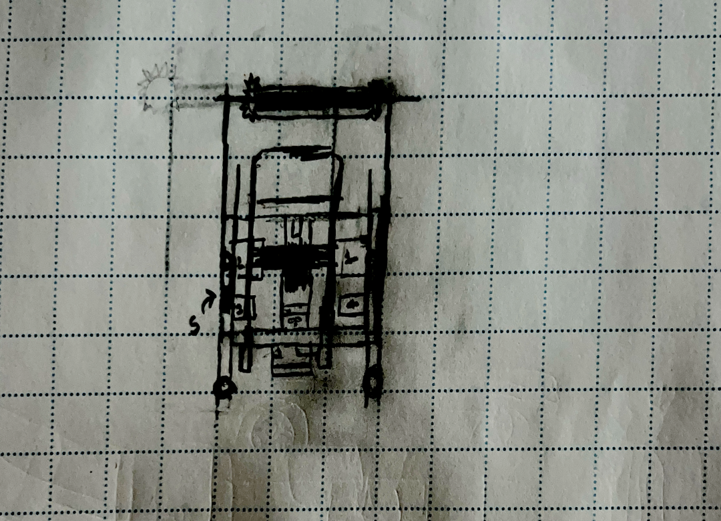
Swish bot 2.0

Slide 14
Roller
Nothing
Nothing
Nothing
Nothing
Nothing
Nothing
Nothing
Launcher
Launcher
Front left wheel
Front right wheel

Slide 15
Roller in
Launcher down
Roller out
Launcher shoot
Forward and backward
None
Left to right
None
None
None
None
None
None
None

Slide 16

“Rapid Relay” Game Field

Slide 17
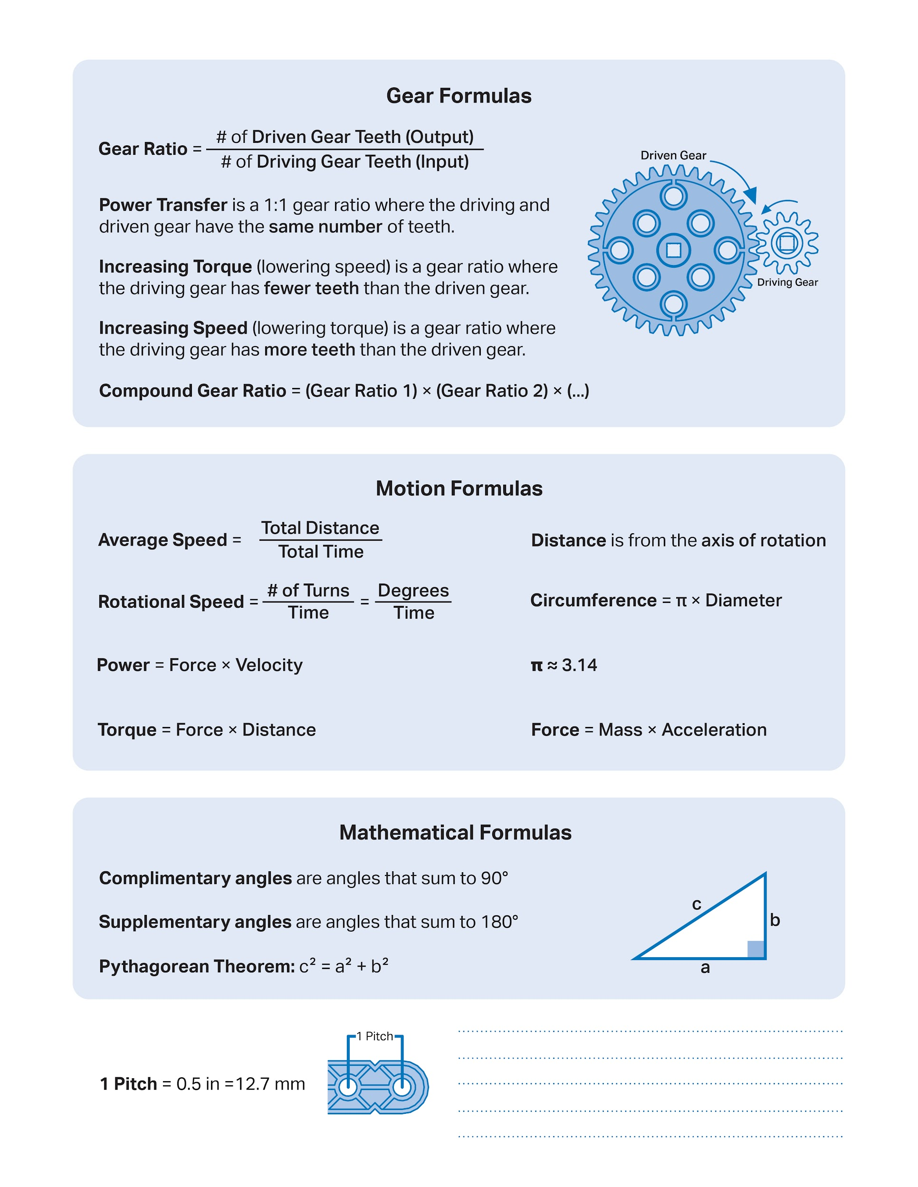

Slide 18
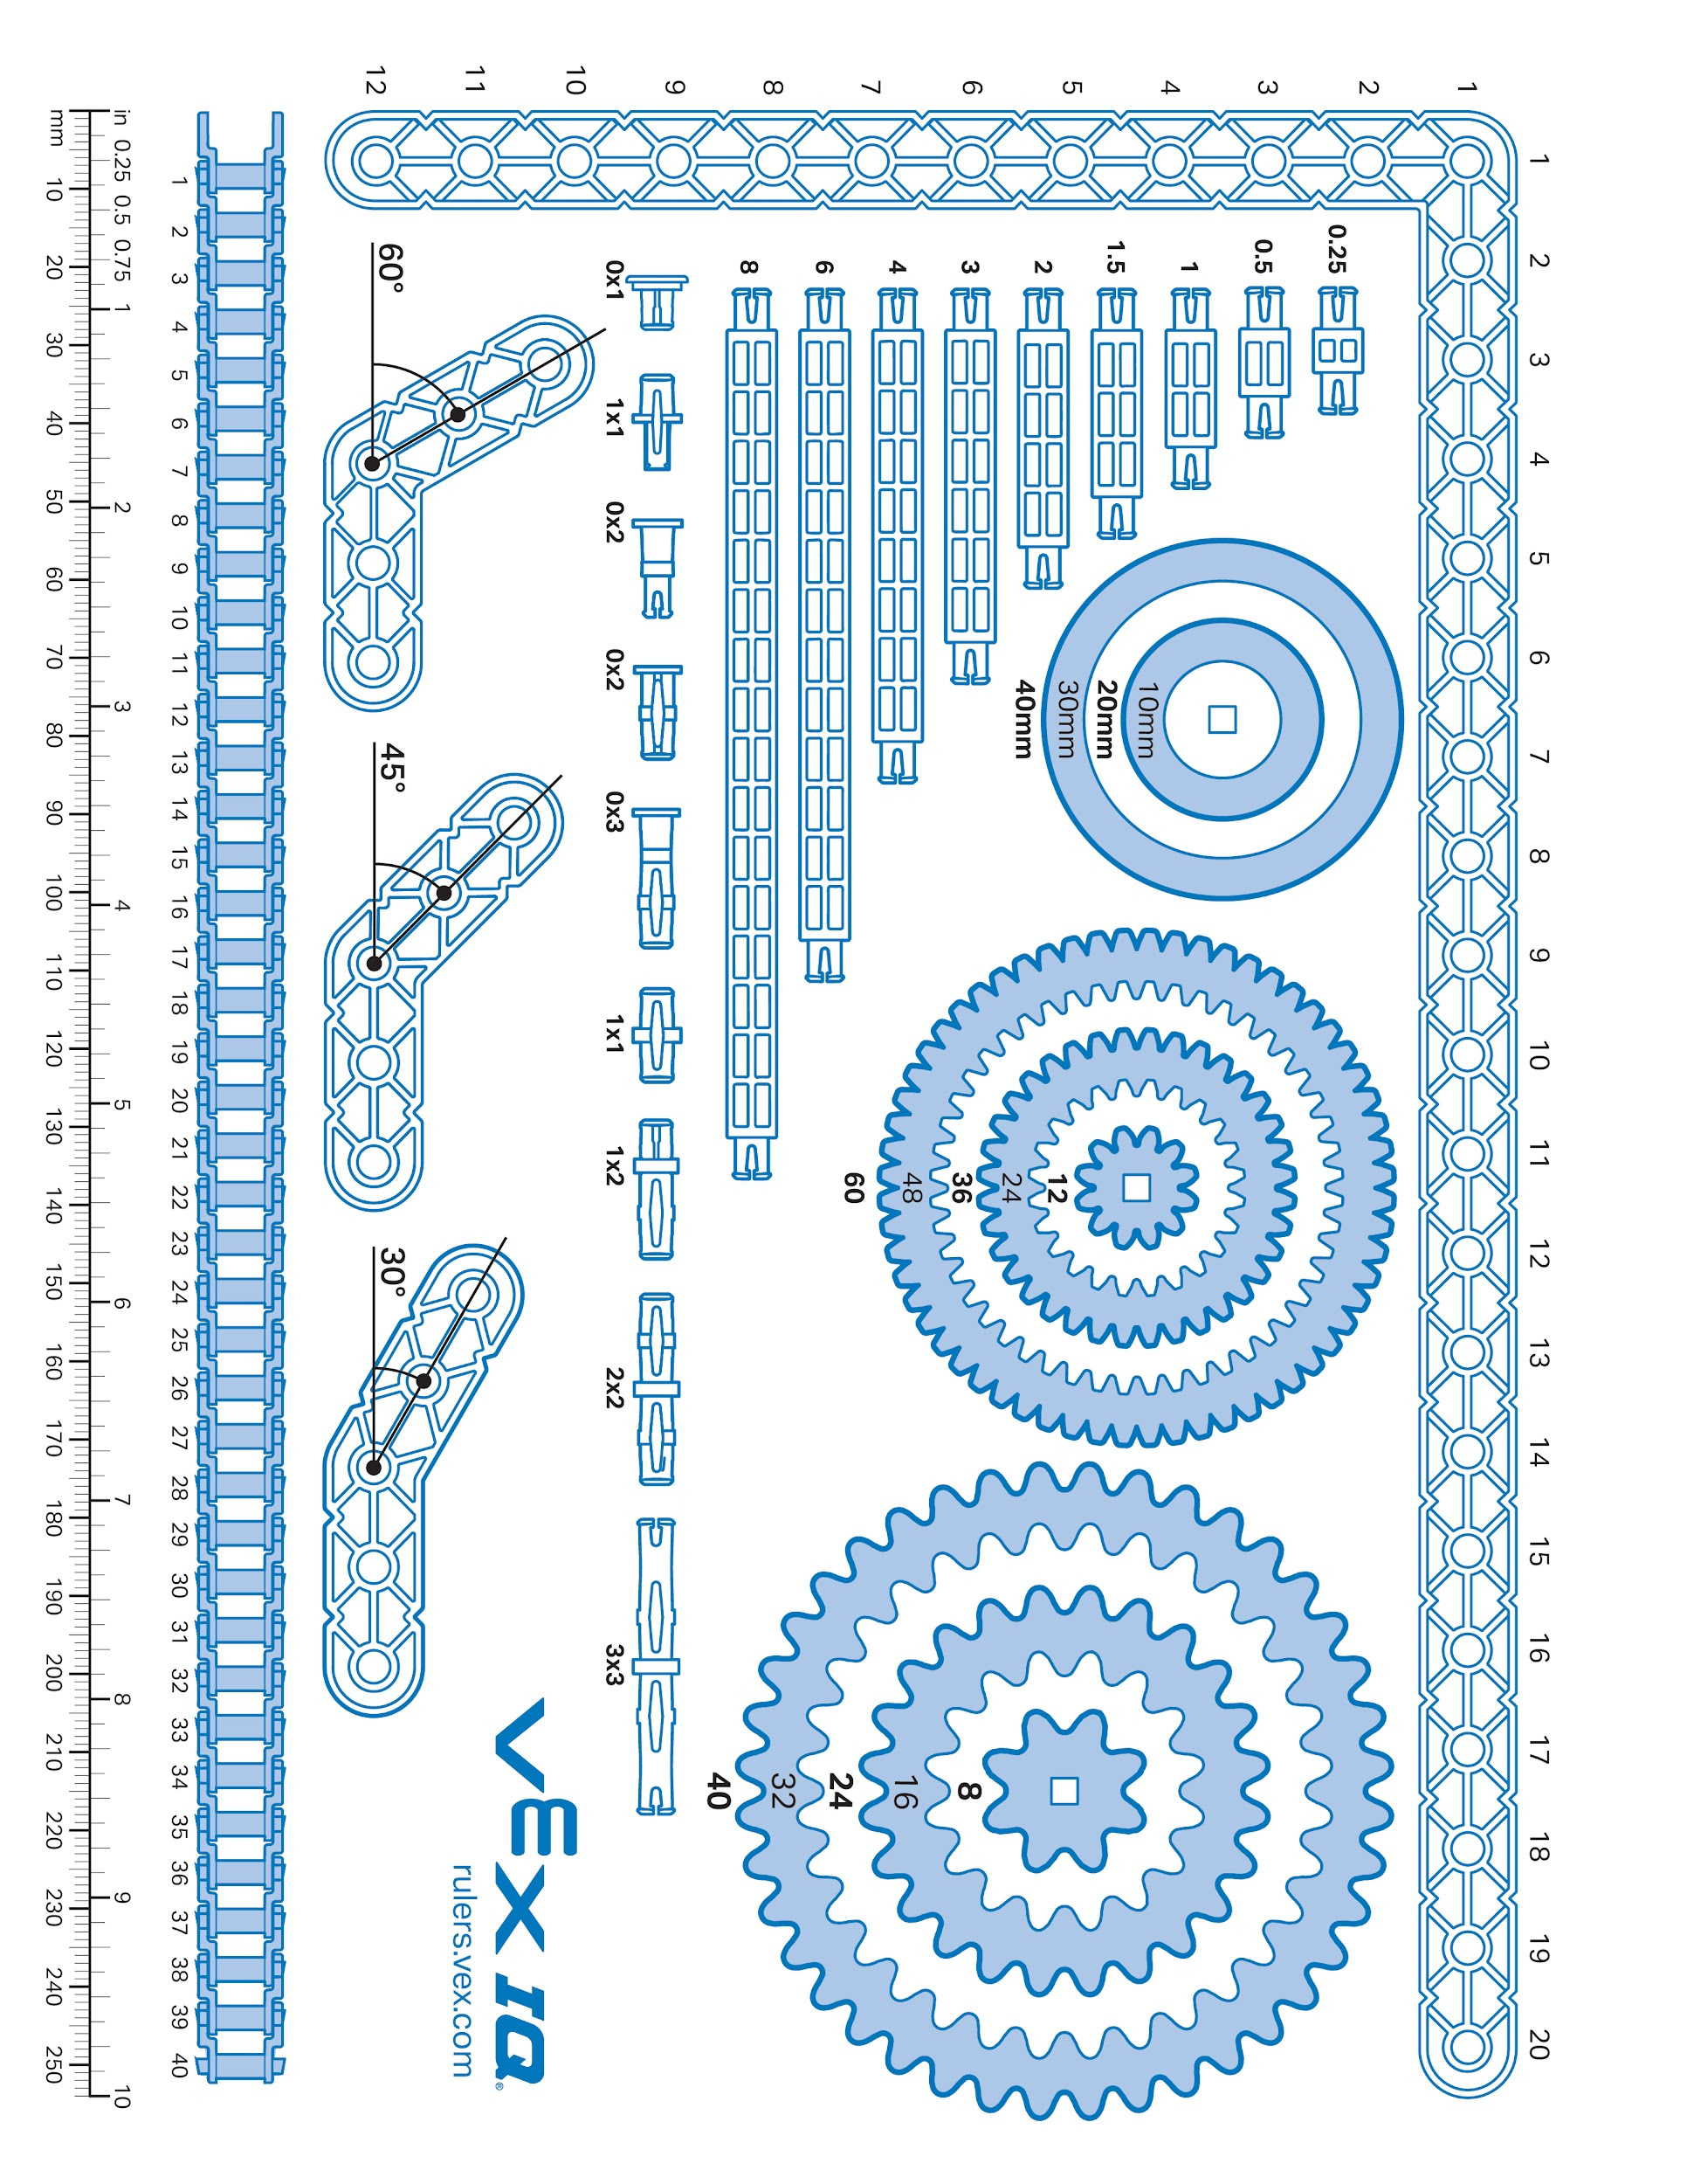

Slide 19
Week of: MM/DD/YYYY

Slide 20
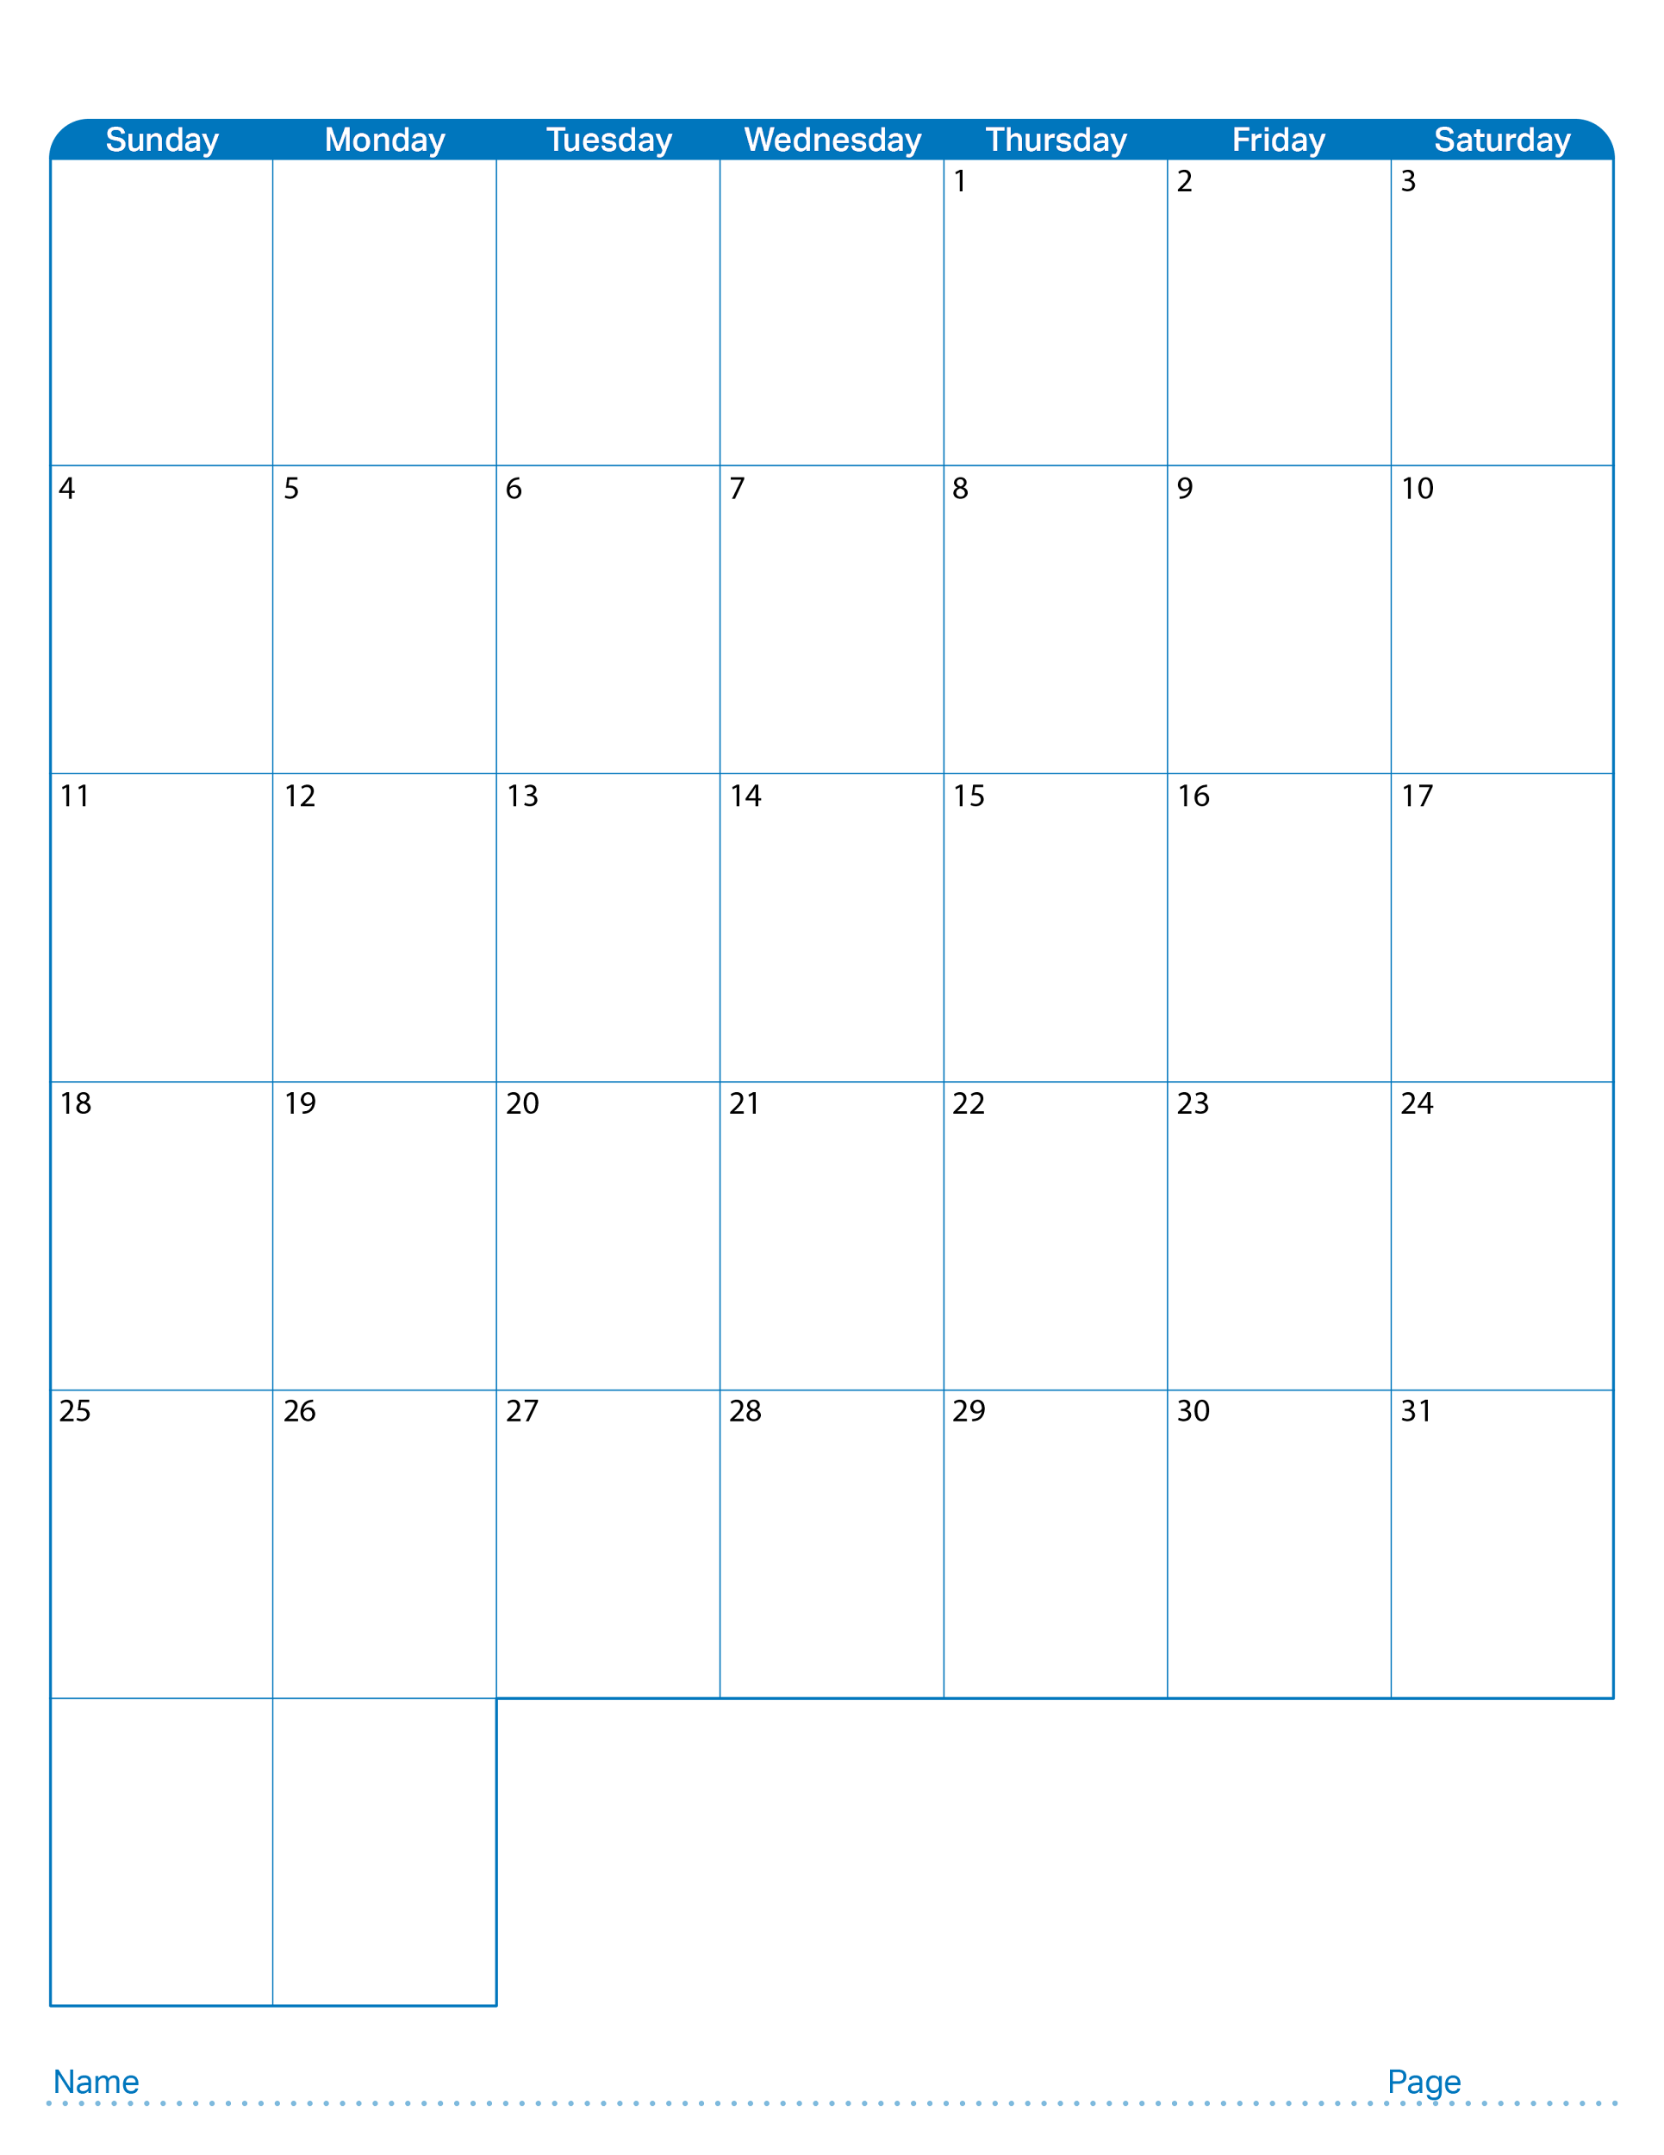
August 2024

Slide 21

September 2024

Slide 22
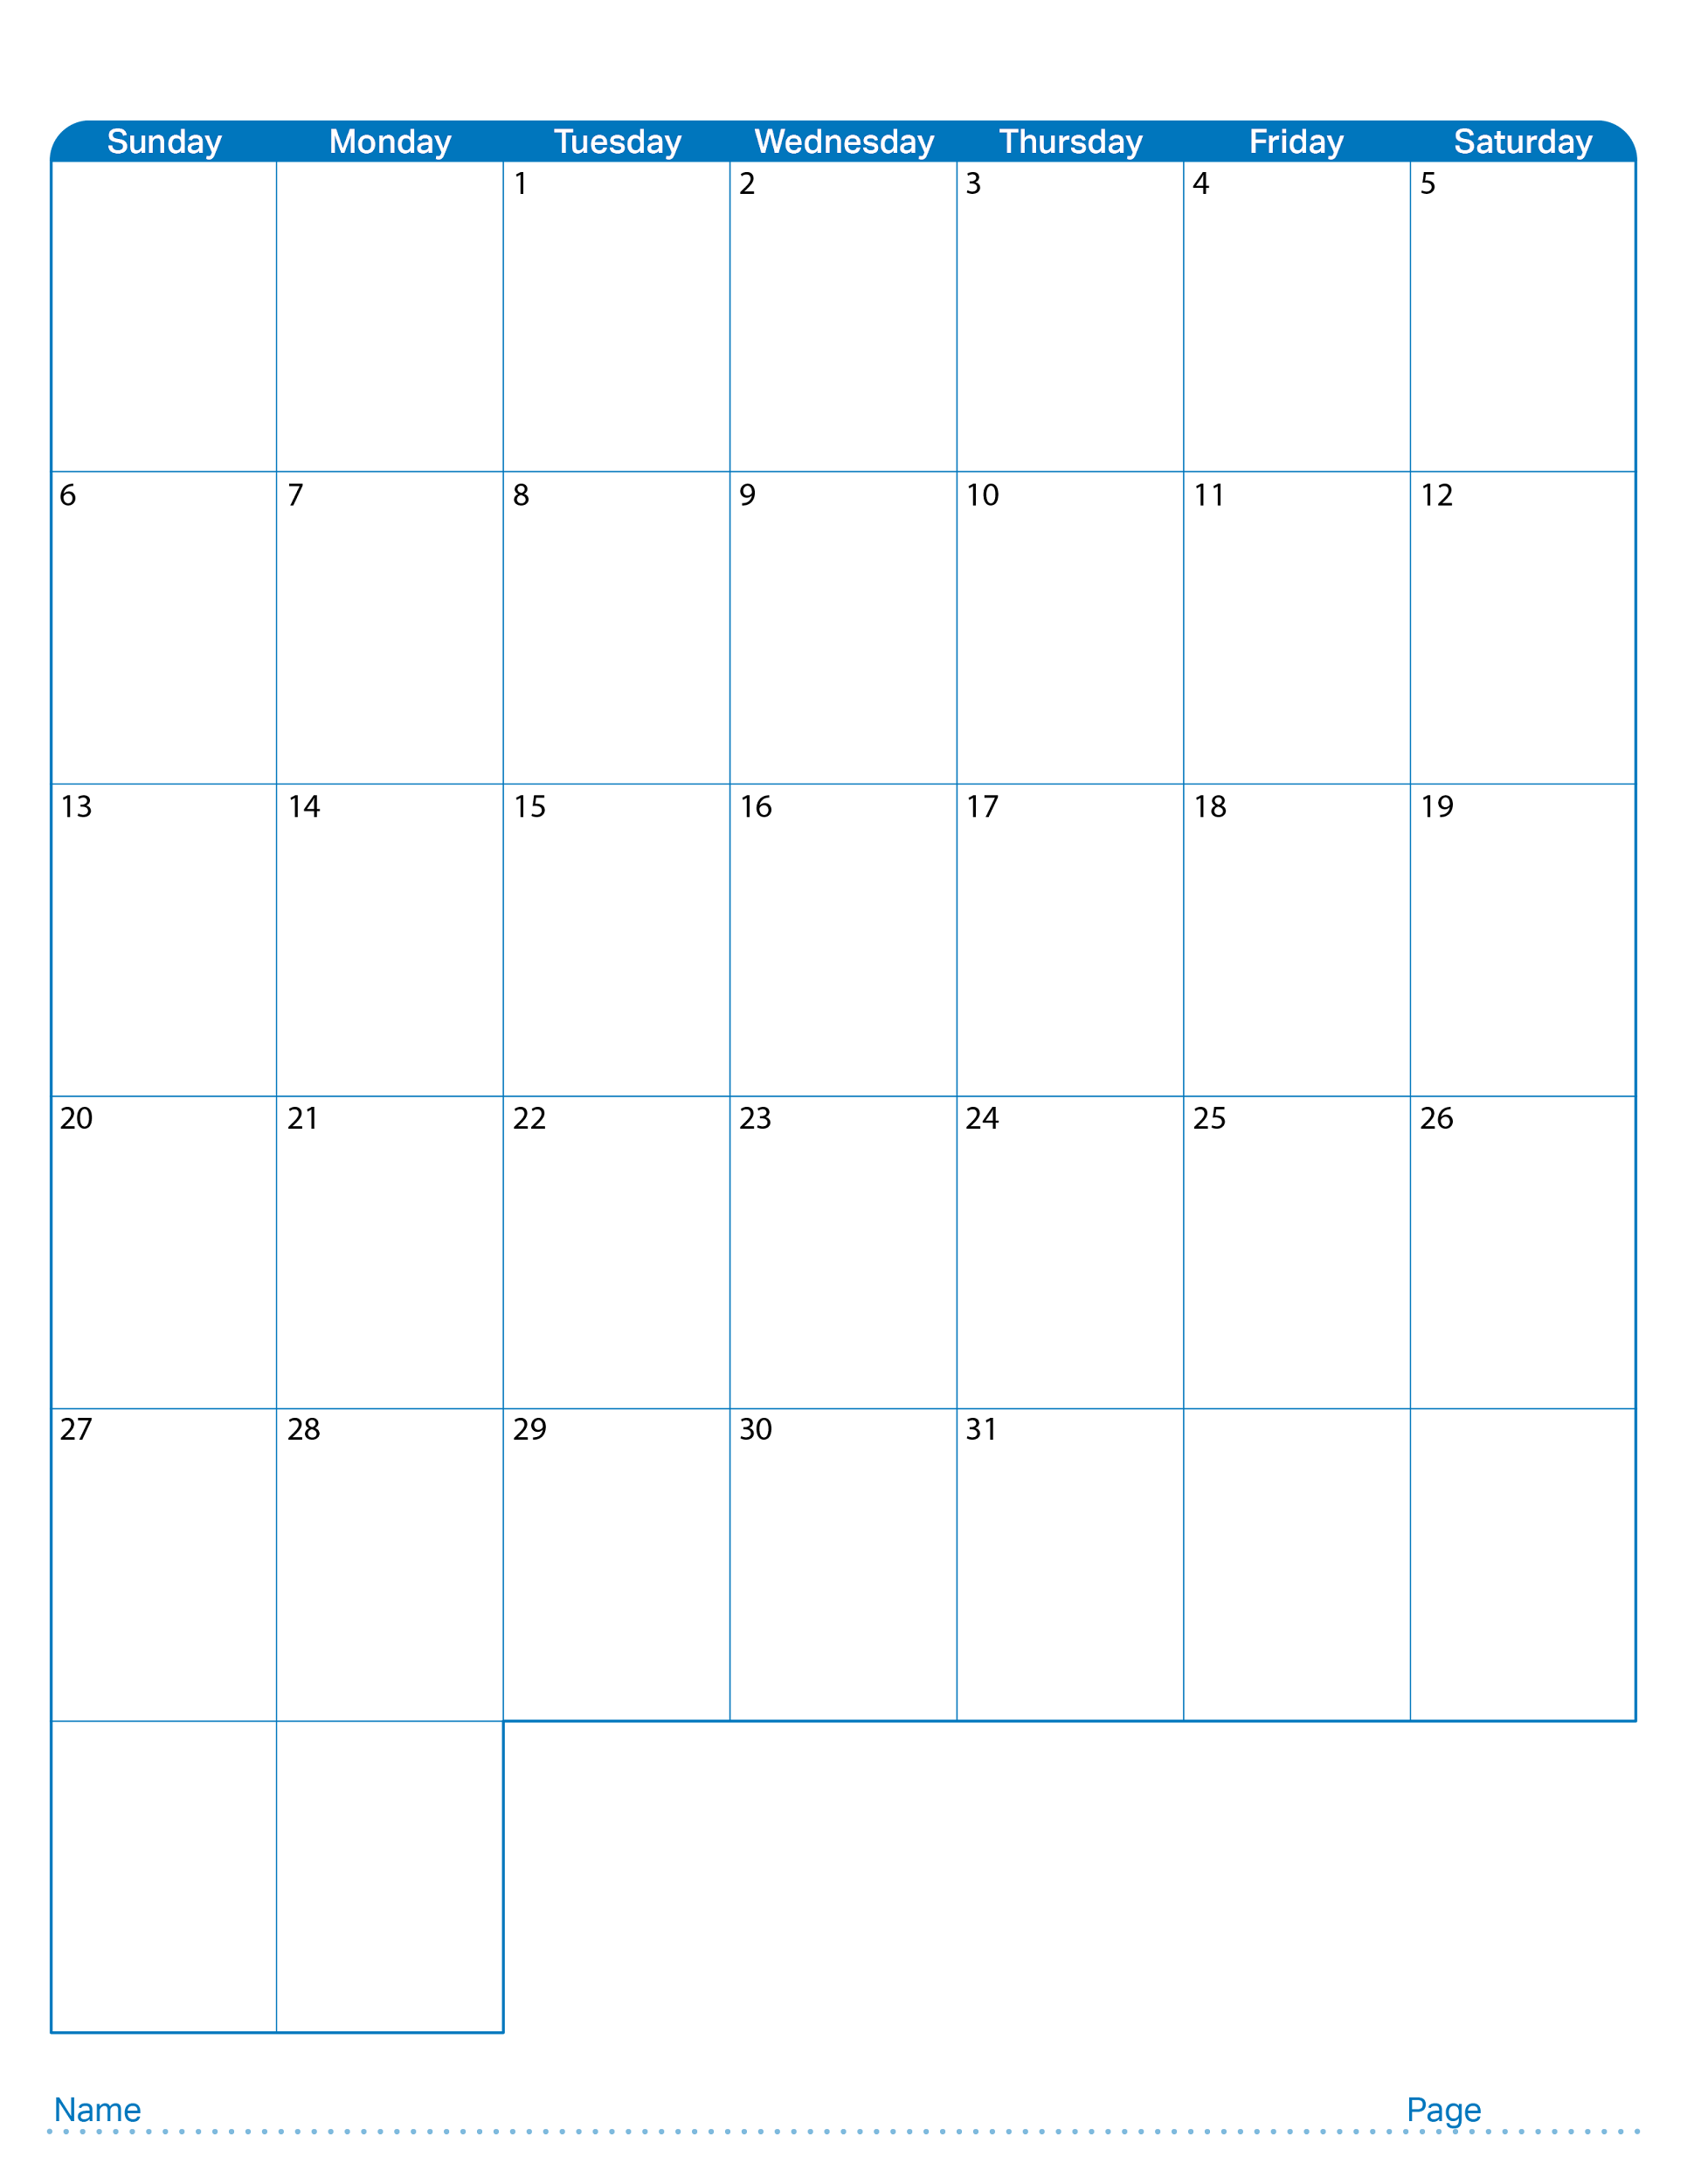
October 2024

Slide 23

November 2024

Slide 24

December 2024

Slide 25

January 2025

Slide 26

February 2025

